Slide 1
MALL MANAGEMENT PORTAL
Database Management Self-Study Project
By:
Aditi Awasthi (1BM16CS008)
Daksh Gandhi (1BM16CS029)
Eleanor Prashamshini (1BM16CS005)

Slide 2
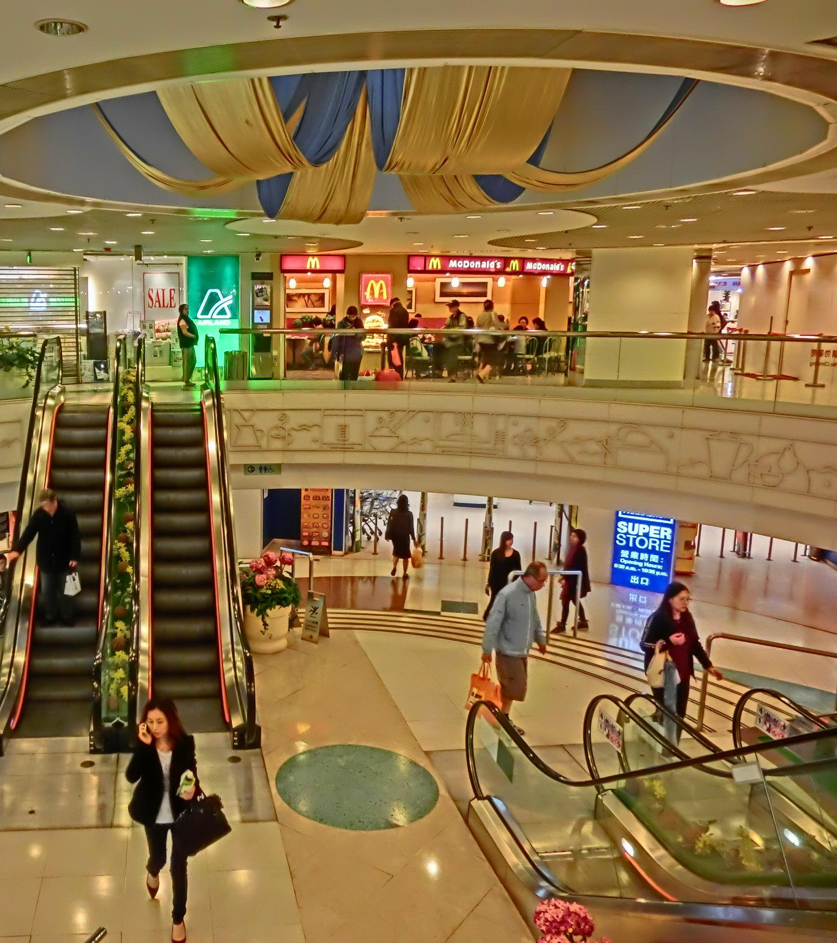
INTRODUCTION
This project revolves around the development of a database application that aims at automating, revolutionizing and simplifying the various aspects of management of a full-scale mall by providing controlled authority to the involved users to manage their respective processes in the system.

Slide 3
REQUIREMENTS
Admin can view the complete list of employees and the net profit.
Shopkeeper controls the employees list and updates the revenues earned.
Arcade employee can generate the membership ID and update the credits for members to play with.
Food court employee can place order for food and generate the receipt for the customer.
Movie theatre employee can update the movies list, change the movie showing in the theatre and book tickets for customers.
Parking lot employee can make the entry for a vehicle, pick a parking spot and generate a bill on exit of the vehicle.

Slide 4
ENTITY - RELATIONSHIP DIAGRAM

Slide 5
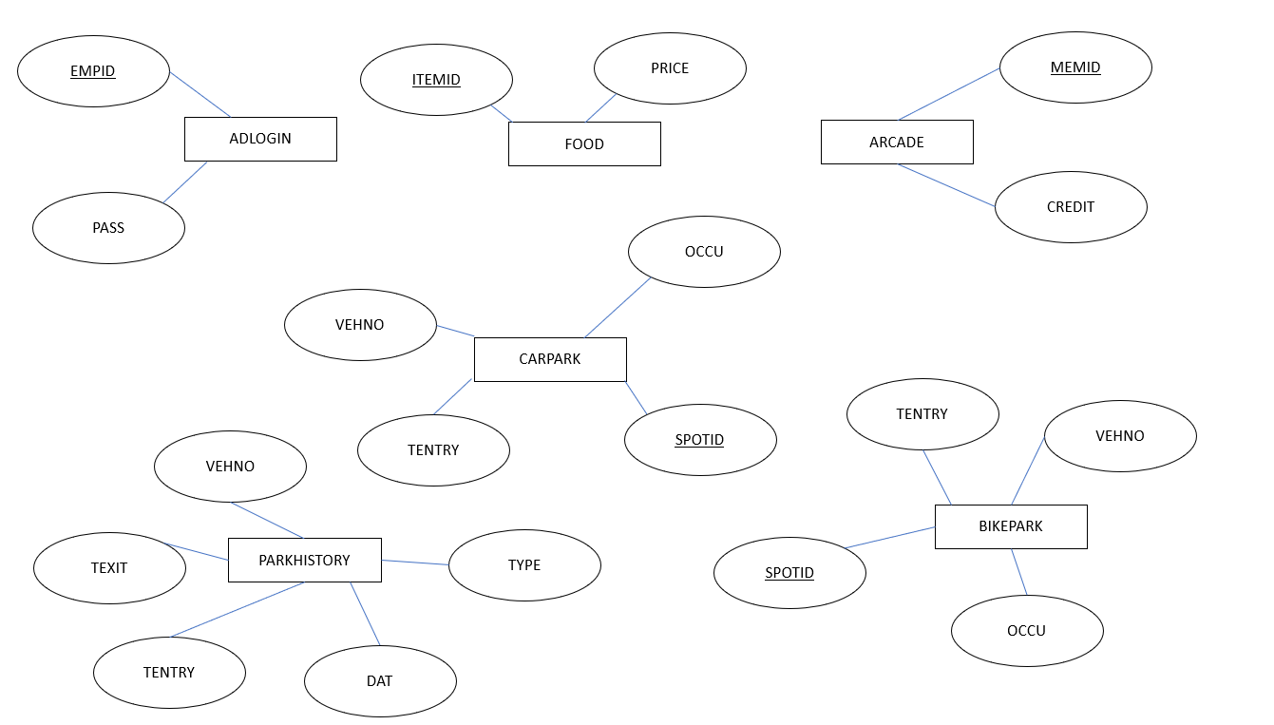

Slide 6
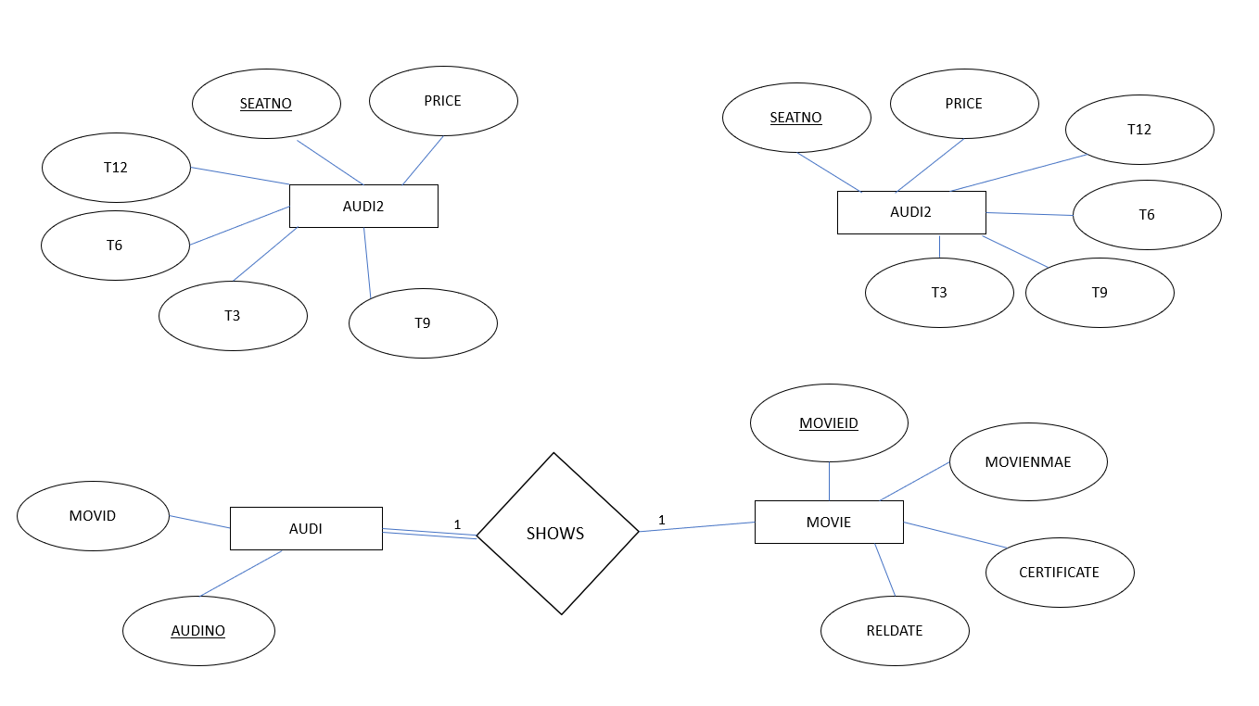

Slide 7
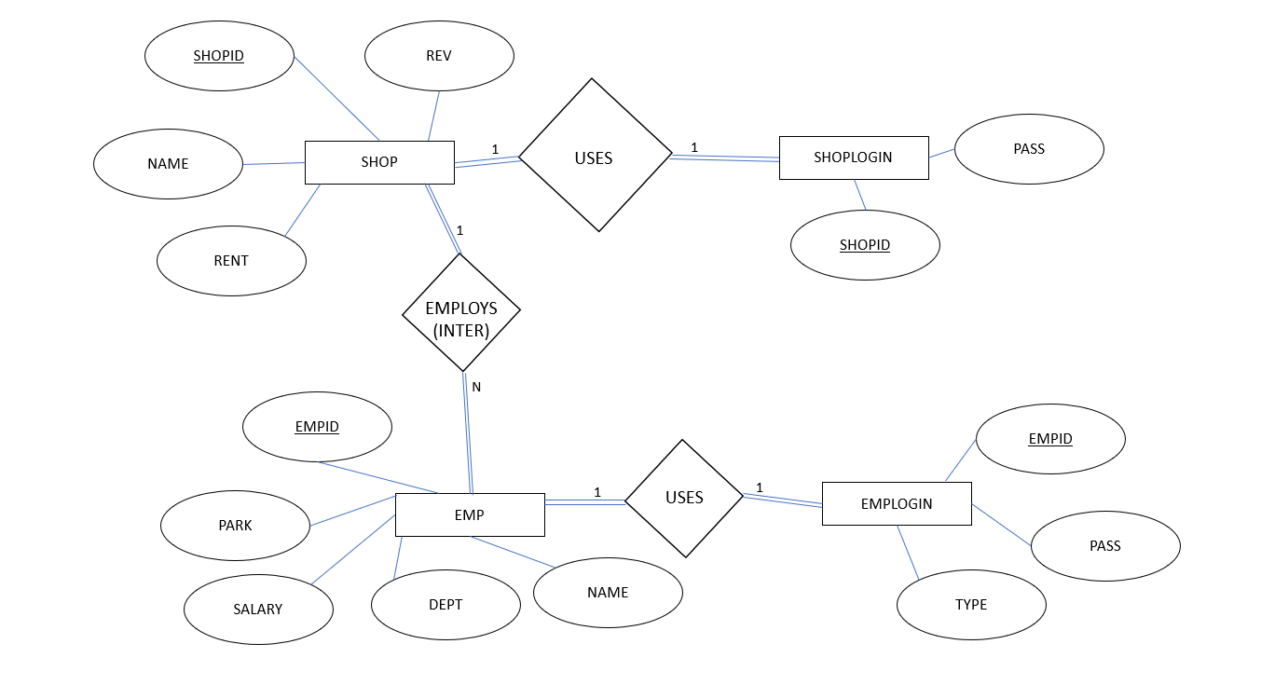

Slide 8
SCHEMA DIAGRAM

Slide 9
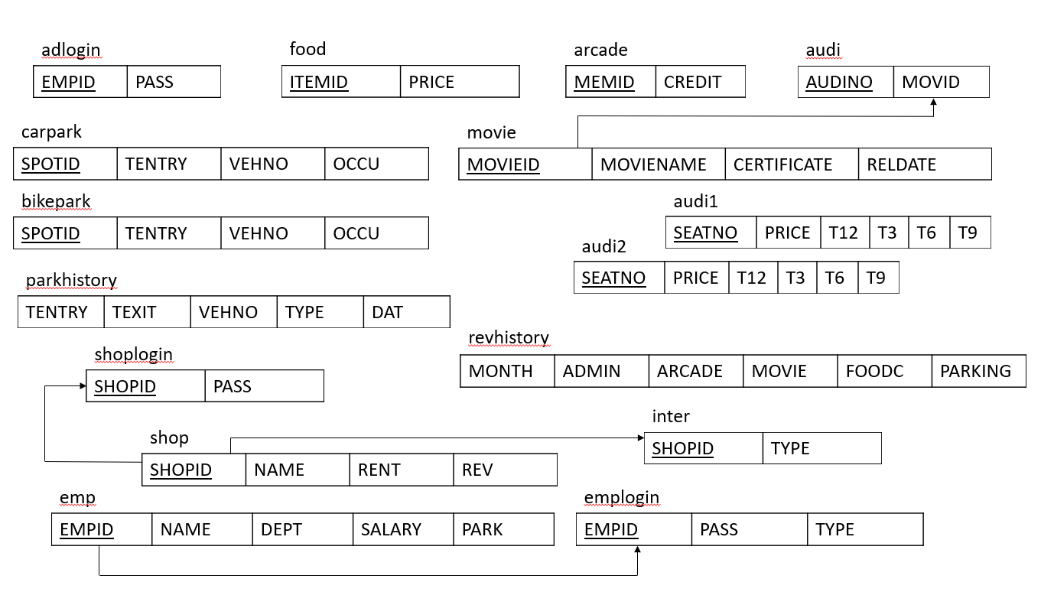

Slide 10
THANK YOU

